Slide 1
MGMT 58600: Python Programming
Lecture 11
Dr. Shoaib Khan

Slide 2
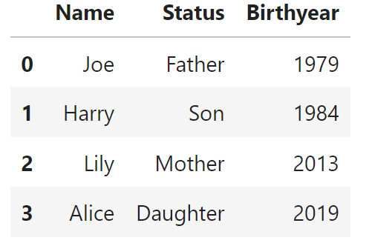
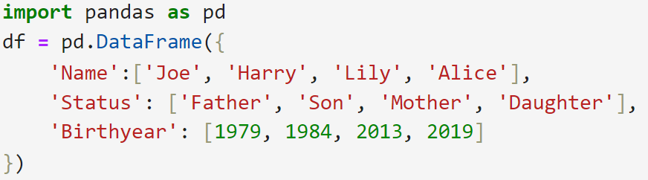
map() method
Pandas map() method for Series is used to substitute each value in a Series with another value
These values may be derived from a function, a dictionay or another series. As an example, consider the data frame below:

Slide 3
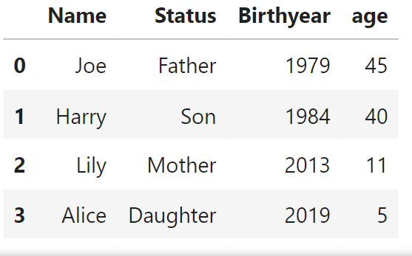
map() method
Suppose we want to add an ‘age’ column which contains the respective ages of all persons in the data frame
We can achieve this by a simple application of the map function as follows:

Slide 4

apply() method
We can also achieve the same results by using the Pandas apply() method
Continuing with the previous example, let’s first delete the ‘age’ column:
Let’s recreate it using the apply() method:

Slide 5
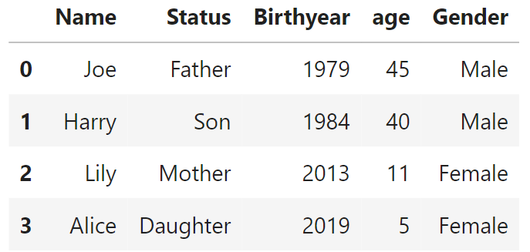
apply() method
Adding a ‘Gender’ column calculated from ‘Status’:

Slide 6
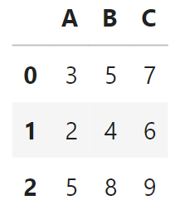
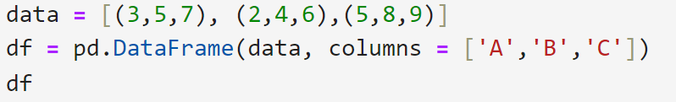
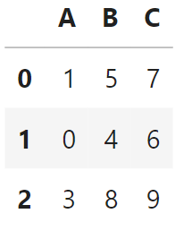

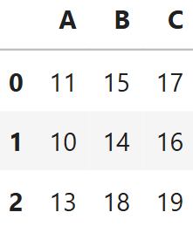
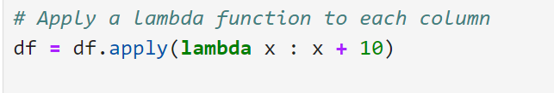
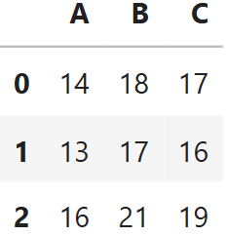
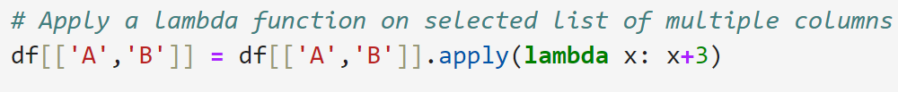
apply() method
Consider the following DataFrame:
Applying a function to a single column:
Applying a function to all the columns:
Applying a function to a list of columns:

Slide 7
Data Aggregation with groupby() Method
The groupby() method allows you to split your data into groups based on some criteria, apply a function (like sum, mean, count) to each group, and combine the results into a new DataFrame or Series.
Basic Syntax
df.groupby(by=grouping_columns)[columns_to_show].aggregation_function()
by: The column(s) you want to group by (e.g., 'Category', 'Department').
[columns_to_show]: (Optional) The specific columns you want to aggregate.
aggregation_function(): The operation to perform on each group (e.g., sum(), mean(), count()).

Slide 8
Case Study: Analysis of Credit Card Approvals
We will be using the Credit Card Approvals available on Kaggle.

Slide 9
Data Visualization
While working with data, it can be difficult to truly understand your data when it’s just in tabular form.
To understand what exactly our data conveys, and to better select suitable models for it, we need to visualize it or represent it in pictorial form.
This helps expose patterns, correlations, and trends that cannot be obtained when data is in a table or CSV file.
This also helps us see trends and patterns in data which descriptive stats alone may not show.

Slide 10
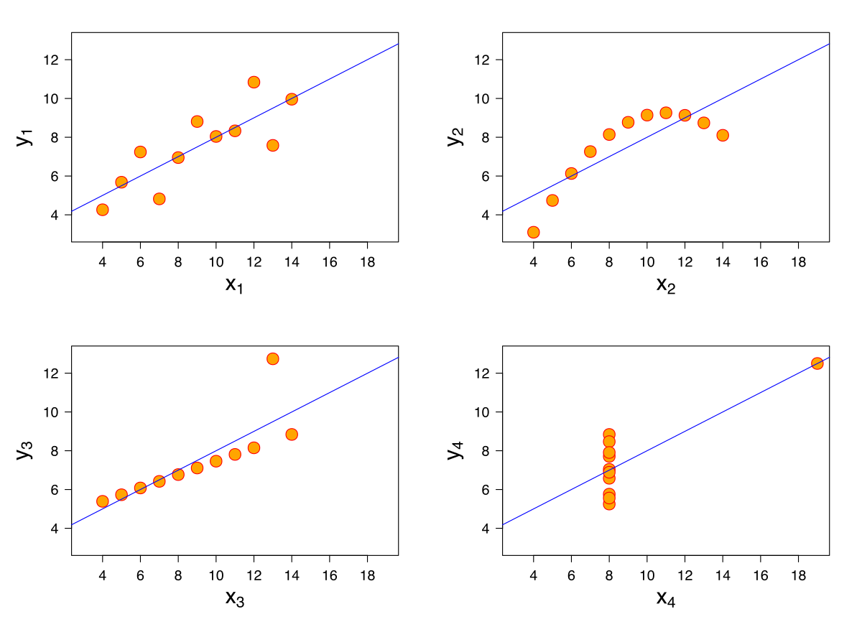
Anscombe’s Quartet
Anscombe's quartet is a group of datasets (x, y) that have the same mean, standard deviation, and regression line, but which are qualitatively different.
It is often used to illustrate the importance of looking at a set of data graphically and not only relying on basic statistic properties.

Slide 11
Data Visualization
The process of finding trends and correlations in our data by representing it pictorially is called Data Visualization.
To perform data visualization in Python, we can use various python data visualization modules such as Matplotlib, Seaborn, Plotly, etc.
Today, we will begin our exploration with Matplotlib and Seaborn.
We will discuss how to work with these modules for data visualization in python and cover the following topics:
Line Charts
Bar Graphs
Histograms
Scatter Plots
Heat Maps

Slide 12

Line Charts
In line charts, each data point or marker is plotted and connected with a line or curve.
Let's consider the apple yield (tons per hectare) in Kanto region (hypothetical).
Let's plot a line graph using this data and see how the yield of apples changes over time.
We start by importing Matplotlib and Seaborn.

Slide 13
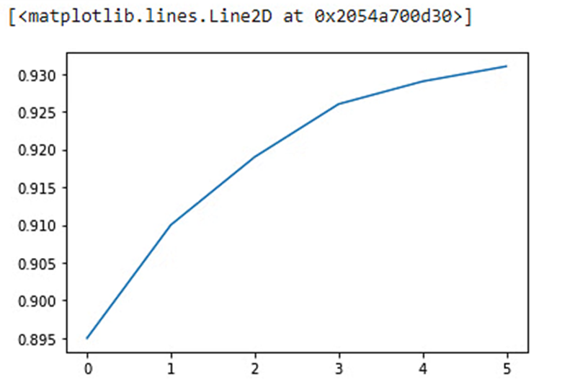
Using Matplotlib
We are using random data points to represent the yield of apples.

Slide 14
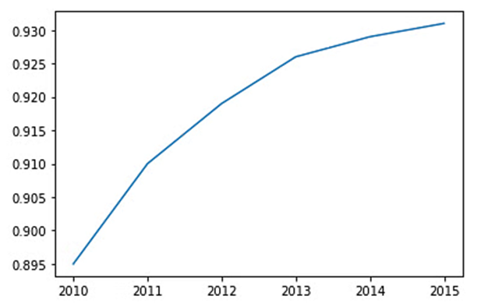
Using Matplotlib
To better understand the graph and its purpose, we can add the x-axis values too.

Slide 15
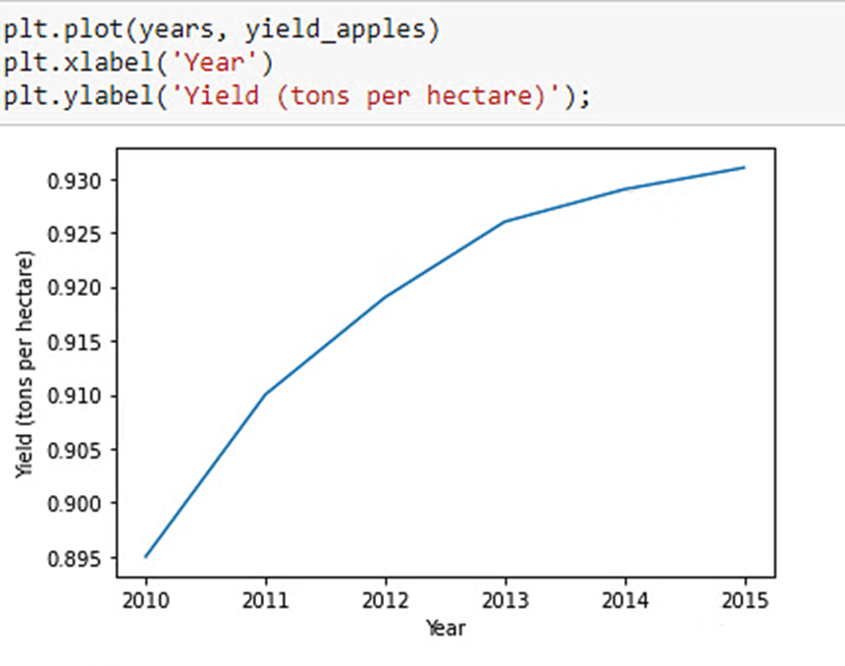
Using Matplotlib
Let's add labels to the axes so that we can show what each axis represents.

Slide 16
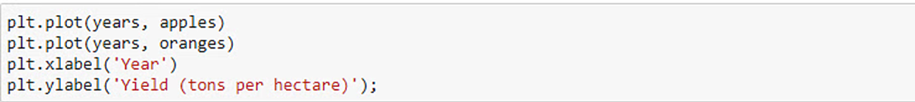
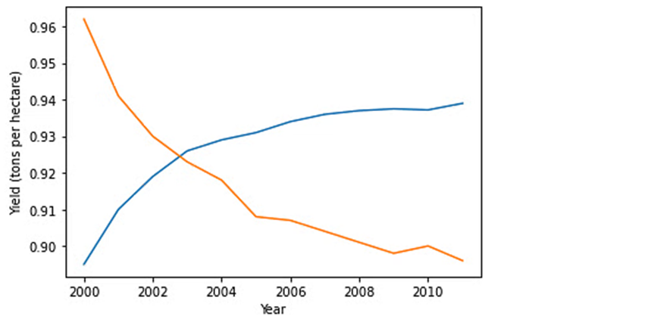
To plot multiple datasets on the same graph, just use the plt.plot function once for each dataset.
Let's use this to compare the yields of apples vs. oranges on the same graph.

Slide 17
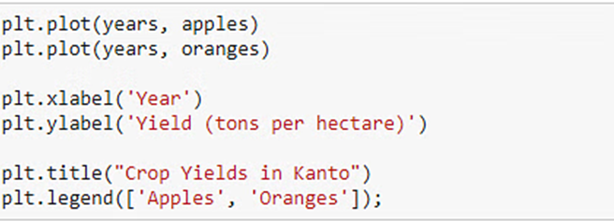
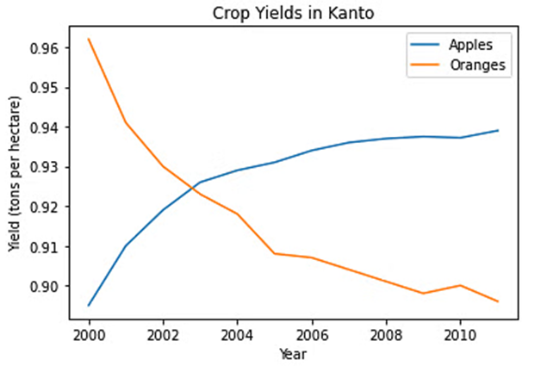
We can add a legend which tells us what each line in our graph means.
To understand what we are plotting, we can add a title to our graph.

Slide 18
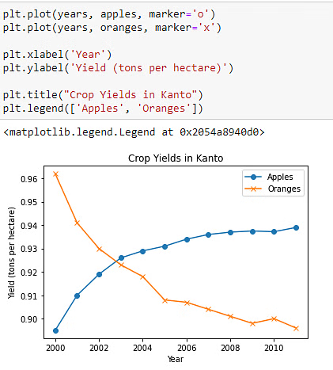
To show each data point on our graph, we can highlight them with markers using the marker argument.
Many different marker shapes like a circle, cross, square, diamond, etc. are provided by Matplotlib.

Slide 19
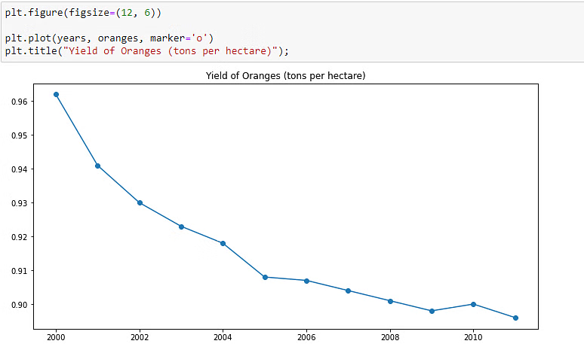
You can use the plt.figure function to change the size of the figure.

Slide 20
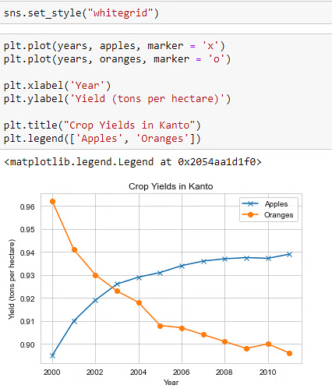
Using Seaborn
An easy way to make your charts look beautiful is to use some default styles from the Seaborn library.
These can be applied globally using the sns.set_style function.

Slide 21
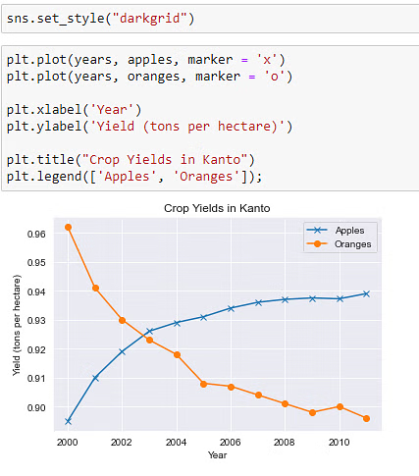
We can also use the darkgrid option to change the background color to a darker shade.

Slide 22
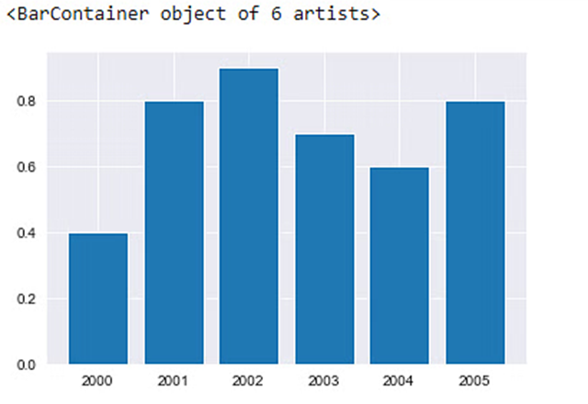
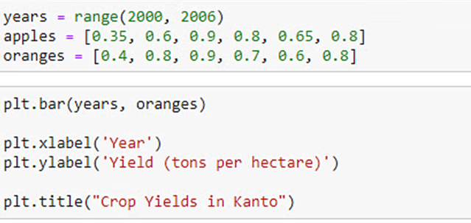
Bar Graphs
When you have categorical data, you can represent it with a bar graph.
A bar graph plots data with the help of bars, which represent value on the y-axis and category on the x-axis.

Slide 23
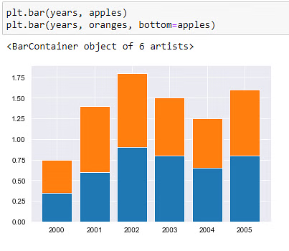
We can also stack bars on top of each other. Let's plot the data for apples and oranges.

Slide 24
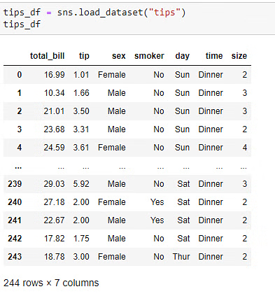
Let’s use the tips dataset in Seaborn next. The dataset consists of :
Information about the sex (gender)
Time of day
Total bill
Tips given by customers visiting the restaurant for a week
We can draw a bar chart to visualize how the average bill amount varies across different days of the week.
We can do this by computing the day-wise averages and then using plt.bar.
The Seaborn library also provides a barplot function that can automatically compute averages.

Slide 25
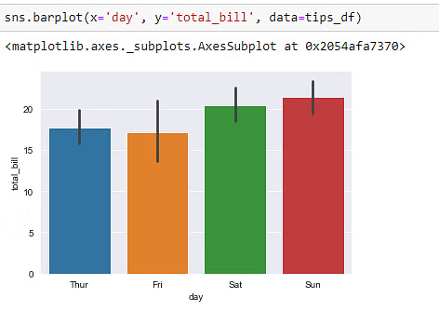

Slide 26
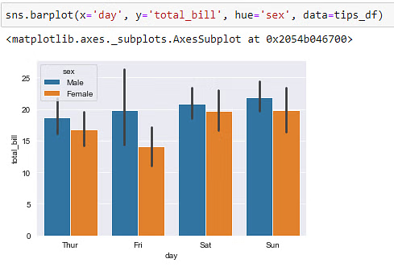
If you want to compare bar plots side-by-side, you can use the hue argument.
The comparison will be done based on the third feature specified in this argument.

Slide 27
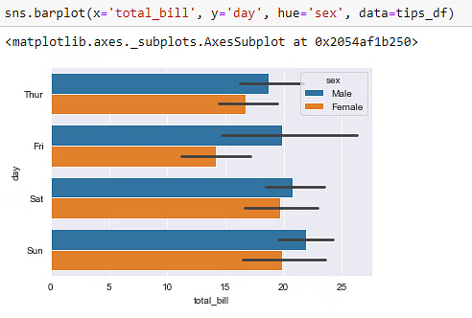
You can make the bars horizontal by switching the axes.

Slide 28
Histograms
A histogram is a visual representation of the distribution of numeric data.
To construct a histogram:
“Bin” (or "bucket") the range of values— divide the entire range of values into a series of intervals
Then count how many values fall into each interval.
The bins are usually specified as consecutive, non-overlapping intervals of a variable.
The bins (intervals) must be adjacent and are often (but not required to be) of equal size

Slide 29
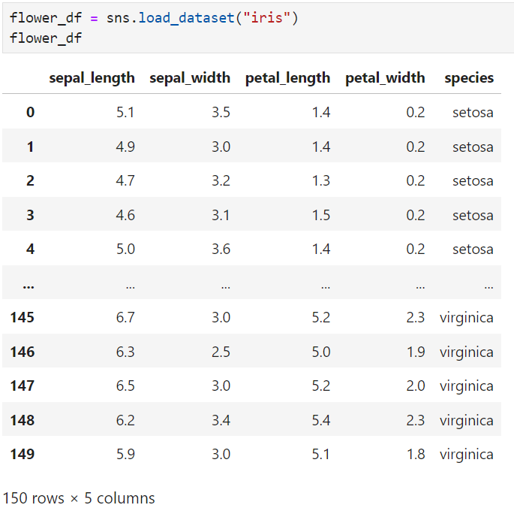

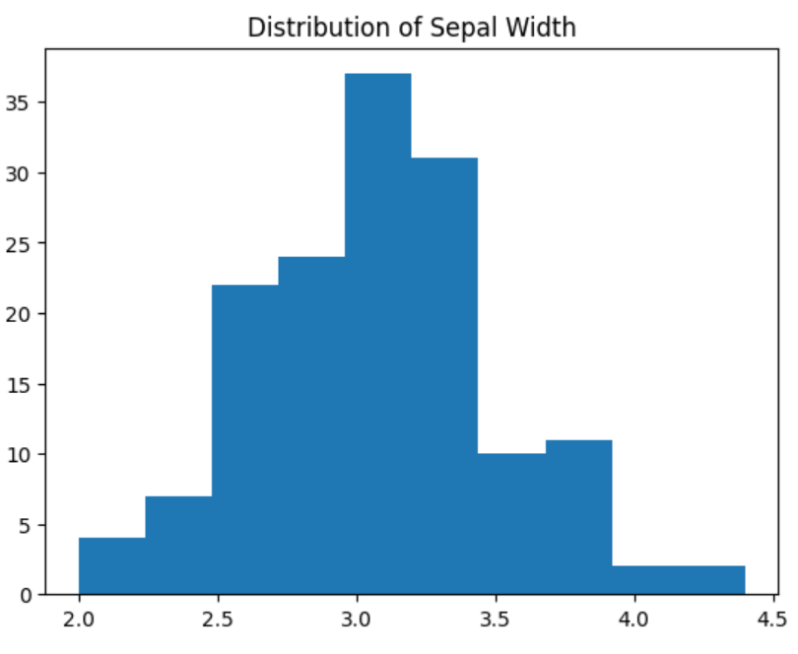
Let's use the ‘Iris’ dataset which contains information about flowers to plot histograms.
Now, let’s plot a histogram using pyplot’s hist() method.

Slide 30
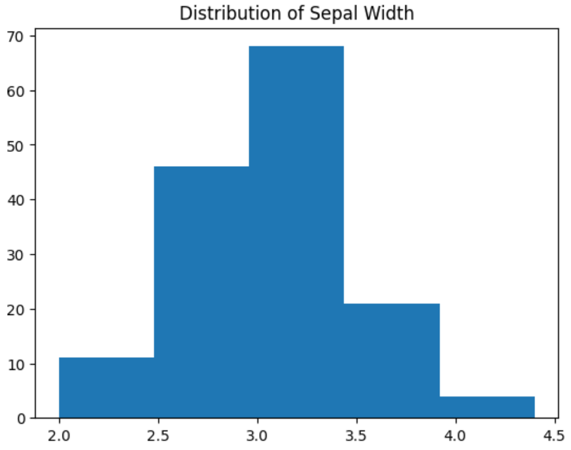

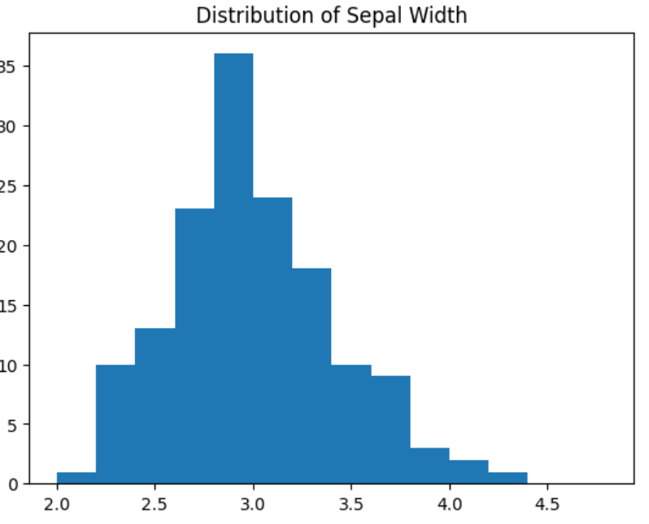
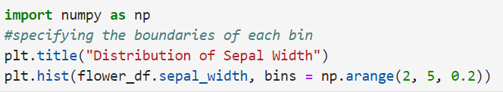
We can control the number or size of bins.
We can change the number and size of bins using numpy too.

Slide 31

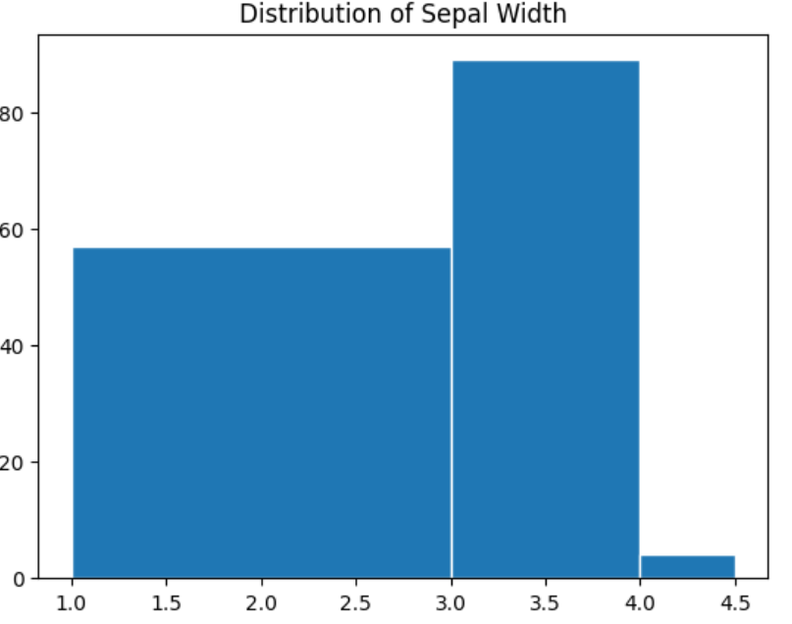
We can also create bins of unequal size.

Slide 32

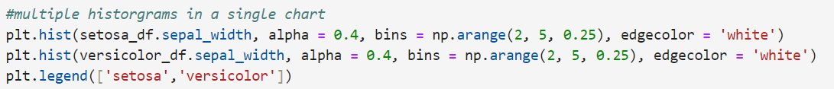
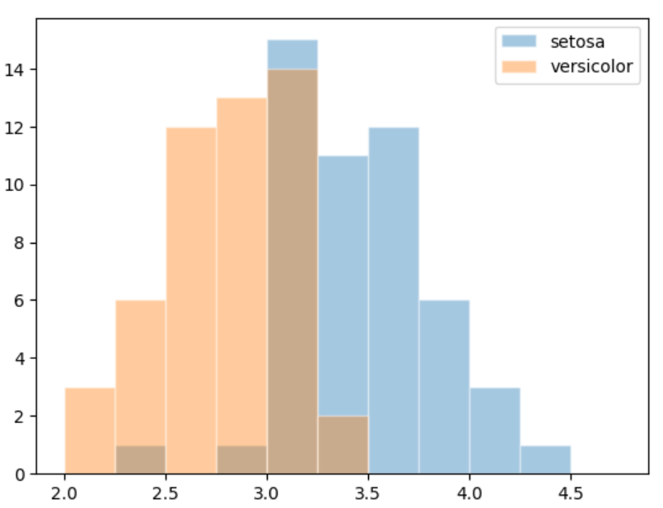
Similar to line charts, we can draw multiple histograms in a single chart.
We can reduce each histogram's opacity so that one histogram's bars don't hide the others.
Let's draw separate histograms for each species of flowers.

Slide 33
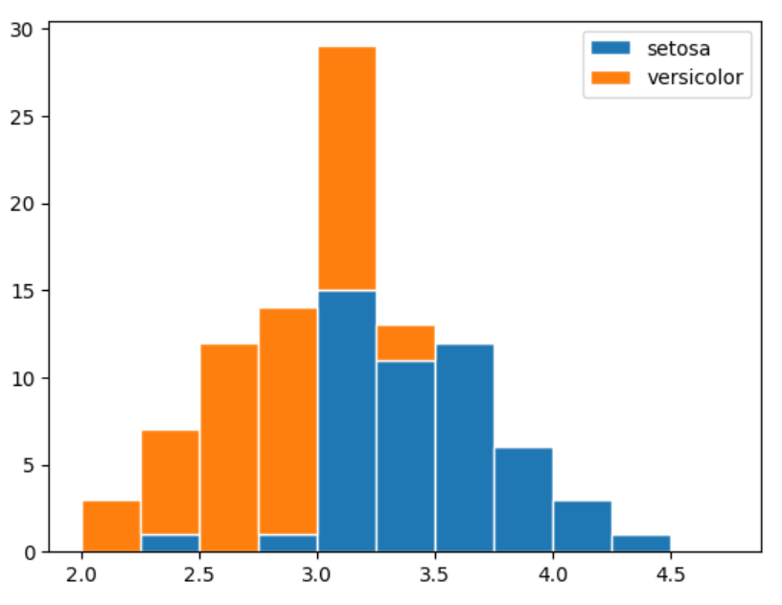
Multiple histograms can be stacked on top of one another by setting the stacked parameter to True.

Slide 34
Scatter Plots
A scatter plot is a type of plot or mathematical diagram using Cartesian coordinates to display values for typically two variables for a set of data.
If the points are coded (color/shape/size), one additional variable can be displayed.
A scatter plot helps identify a possible relationship between changes observed in two different sets of variables.
It provides a visual and statistical means to test the strength of a relationship between two variables

Slide 35

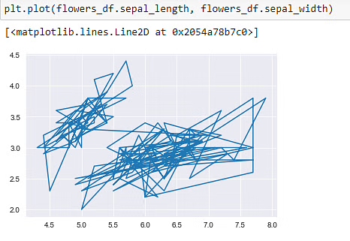
First, let’s see how many different species of flowers we have.
Let’s try plotting the data with the help of a line chart.

Slide 36
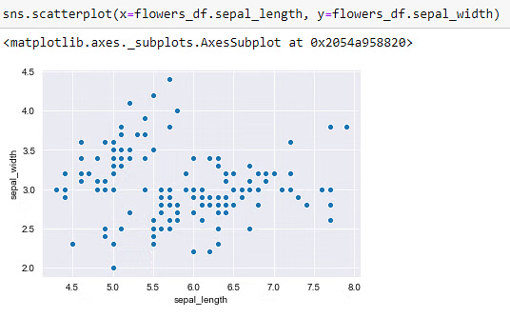
This visualization in previous slide was not very informative. We cannot figure out the relationship between different data points.
Let’s visualize the same data using scatterplots.
This is much better. But we still cannot differentiate different data points belonging to different categories

Slide 37
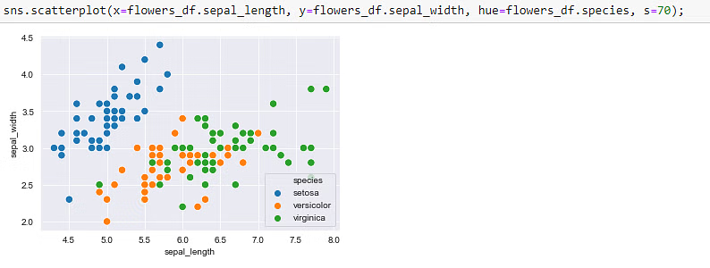
We can color the dots using the flower species as a hue.

Slide 38
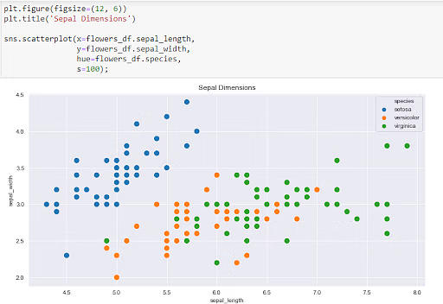
Since Seaborn uses Matplotlib's plotting functions internally, we can use functions like plt.figure and plt.title to modify the figure.

Slide 39
Heat Maps
A heat map (or heatmap) is a 2-dimensional data visualization technique that represents the magnitude of individual values within a dataset as a color.
The variation in color may be by hue or intensity.
Based on how these colors range in hues, intensity, etc., tells us how a phenomenon varies.
Let's use heatmaps to visualize monthly passenger footfall at an airport over 12 years from the flights dataset in Seaborn.

Slide 40
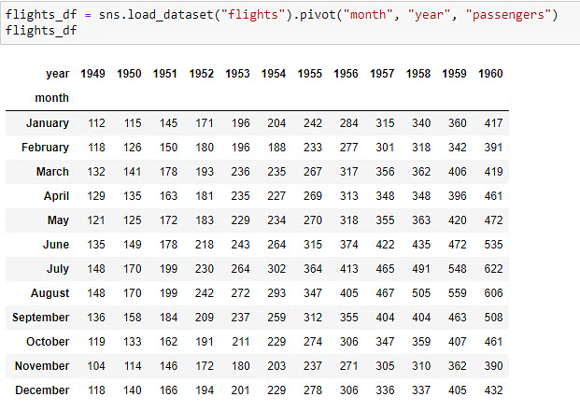
The dataset below shows us the monthly footfall in an airport for each year, from 1949 to 1960.
The values represent the number of passengers (in thousands) that passed through the airport.

Slide 41
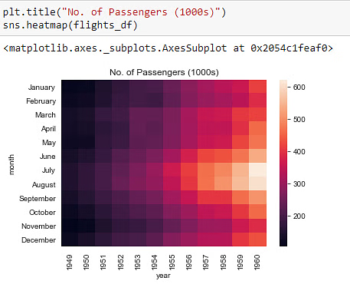
Let’s use a heatmap to visualize the above data.

Slide 42
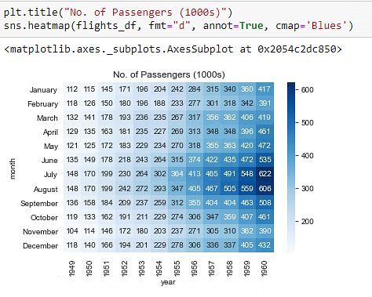
The brighter the color, the higher the footfall at the airport. By looking at the graph, we can infer that :
The annual footfall for any given year is highest around July and August.
The footfall grows annually. Any month in a year will have a higher footfall when compared to the previous years.
Let's display the actual values in our
heatmap and change the hue to blue.

Slide 43
Univariate, Bivariate and Multivariate Analysis
Three common approaches used in statistics and data analysis to explore and understand data
Univariate analysis involves the examination of a single variable (or feature) at a time
Univariate analysis is primarily used to:
summarize and visualize the distribution of a single variable,
assess its central tendency (mean, median, mode),
dispersion (range, variance, standard deviation), and
shape (e.g., histogram, box plot).
helps in understanding the characteristics of a single variable in isolation.

Slide 44
Univariate, Bivariate and Multivariate Analysis
Bivariate analysis involves the analysis of two variables simultaneously to determine if there is a relationship or association between them.
Bivariate analysis is used to understand the relationship, correlation, or association between two variables.
Common techniques for bivariate analysis include scatter plots, correlation coefficients (e.g., Pearson’s correlation), and contingency tables (for categorical variables).
It helps answer questions like, “Is there a relationship between a person’s age and their income?”

Slide 45
Univariate, Bivariate and Multivariate Analysis
Multivariate analysis involves the simultaneous analysis of three or more variables to understand the complex relationships and interactions among them.
It extends beyond the scope of univariate and bivariate analysis to consider multiple factors at once.
Multivariate analysis is essential for understanding more complex relationships in data, such as predicting an outcome based on multiple predictor variables or clustering similar observations based on multiple characteristics.

